Slide 1

Data Science For Business
January 2025
Module 2 – Supervised Segmentation

Slide 2
Syllabus Reminder
ChatGPT
Late penalty
Participation

Slide 3
EV[Decision] >= EV[Not Decision]

Slide 4
Quiz time!

Slide 5
Quiz discussion!

Slide 6
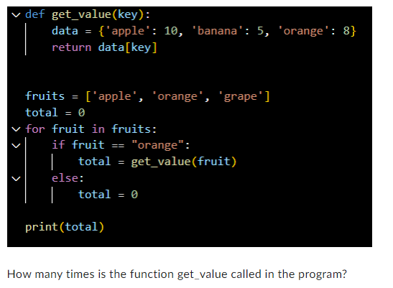
Q1
0
1
2
3

Slide 7
Q1
0
1
2
3

Slide 8
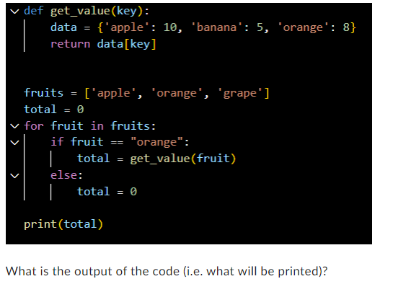
Q1
18
25
8
0

Slide 9
Q2
18
25
8
0

Slide 10
Q3
df.head()
df.describe()
df.info()
df.stats()

Slide 11
Q3
df.head()
df.describe()
df.info()
df.stats()

Slide 12
Q4

Slide 13
Q4
Markdown
Python code

Slide 14

Q5

Slide 15
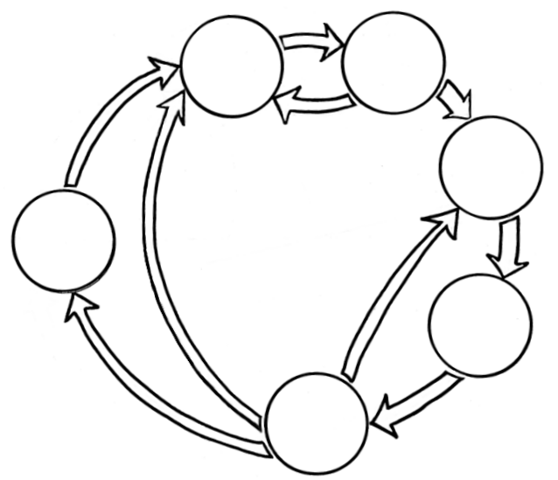

Q5
Business Understanding
Data Understanding
Data Preparation
Data Science
Process
Deployment
Modeling
Evaluation

Slide 16
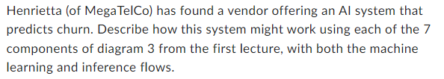
Q6

Slide 17
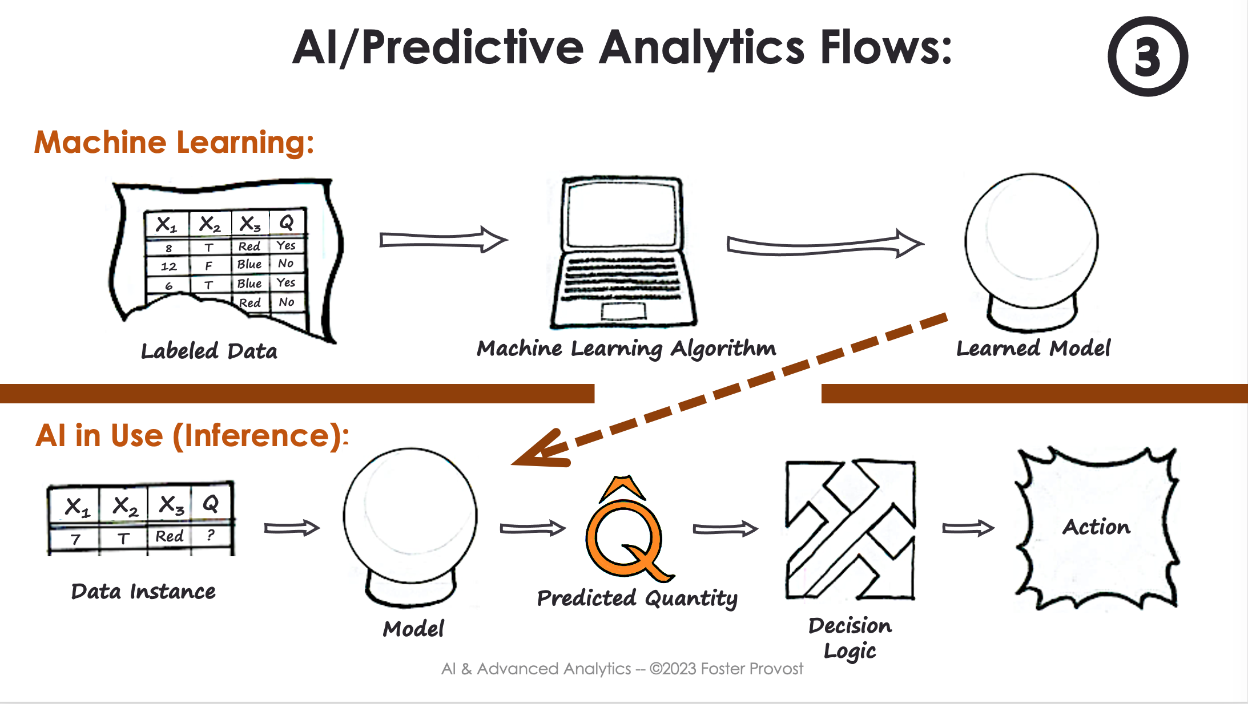
Q6

Slide 18
Agenda
Week 1
Module 1 (Thursday): Intro to data science + Python for DS
Module 2 (Friday): Intro to supervised learning
Week 2
Module 3 (Monday): Fitting models, generalization
Module 4 (Tuesday): Regularization
Module 5 (Wednesday): Evaluation (ROC, cost visualization)
Module 6 (Thursday): Modeling text data
Week 3
Module 7 (Monday): Neural networks, GenAI
Module 8 (Tuesday): Guest lecture(s)
Module 9 (Wednesday): Causal inference, AB testing, wrap up
Final Exam (Thursday)

Slide 19
Where we are
Business Understanding
Data Understanding
Data Preparation
Data Science
Process
Deployment
Modeling
Evaluation

Slide 20

Where we are
Business Understanding
Data Understanding
Data Preparation
Data Science
Process
Deployment
Modeling
Evaluation

Slide 21

Where we are

Slide 22
Supervised Learning
Features
ID (?)
Target
Name | Head | HeadSize | BodyType | BodyShading | Buy?
Amy | Round | Regular | Oval | Light | N
Bani | Triangle | Regular | Oval | Dark | N
Crista | Round | Regular | Rectangle | Light | Y
Dev | Round | Regular | Rectangle | Light | Y
Eliza | Round | Regular | Rectangle | Light | Y
Fran | Triangle | Regular | Rectangle | Dark | N
Gianna | Round | Regular | Rectangle | Light | Y
Hector | Round | Large | Oval | Light | N
Irina | Round | Regular | Oval | Light | N
Jaquie | Round | Large | Rectangle | Light | Y
Kendra | Round | Large | Oval | Light | N
LaToya | Triangle | Regular | Oval | Light | Y
Instances,
observations

Slide 23
Supervised Learning = Prediction/Predictive Analytics
Features: what we use to predict (also, explanatory variables, independent variables)
Target: what we aim to predict

Slide 24
Coding time!

Slide 25
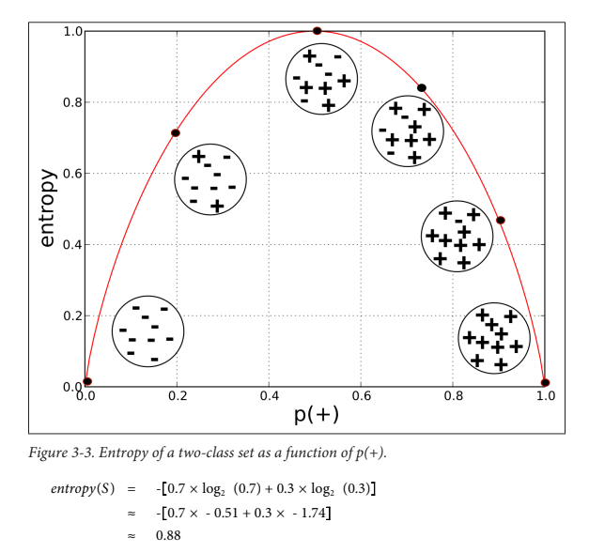
Entropy (H)

Slide 26
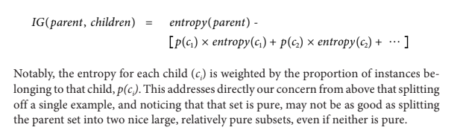
Information Gain (IG)

Slide 27
Coding time!

Slide 28
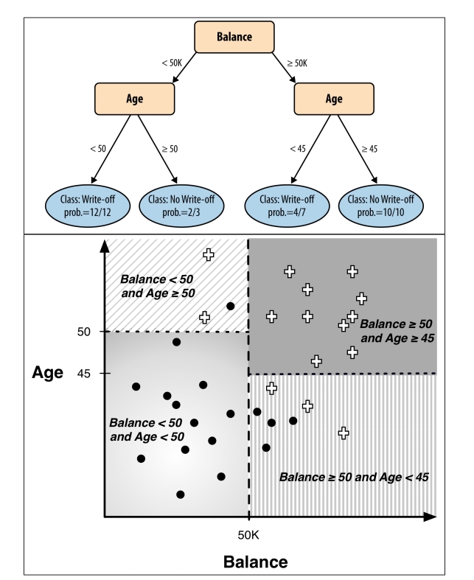
Decision Tree

Slide 29
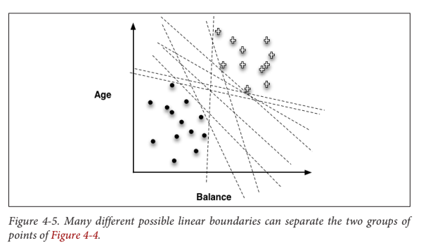
Linear Separator

Slide 30
Linear Separator
Objective function
(Loss function) = describes how “badly” a model fits our (training) data
We pick model parameters (in this case, lines) to minimize loss
This function can be many things (don’t worry about the details now), but our choice of loss function affect what the final “machine learned” model will be

Slide 31
Linear Separator
Objective function
(Loss function) = describes how “badly” a model fits our (training) data
We pick model parameters (in this case, lines) to minimize loss
This function can be many things (don’t worry about the details now), but our choice of loss function affect what the final “machine learned” model will be
We’ll talk more about this next week!

